Slide 1
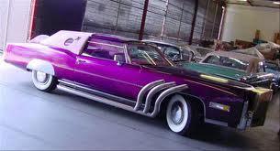
The Time Bandit!!!!
By, Michael Weyman
Nick McCarthy
Dead Mills

Slide 2
Time Travelers Inc.
The Designer: Nick
The Inventor: Michael
The Scientist: Dead (Unknown Causes)

Slide 3
Proposal for Endorsement
The Only Luxury Time Machine
Built For a Family
Doesn’t Corrupt The Space Time Continuum
Can Travel to any time, just don’t forget where you leave it!
Will sell at $999,999,999,999.99 plus Shipping & Processing
We only accept Discover card, and Cash (upfront)

Slide 4
Why We Outperform Others
No risk while using our time machine, It has an auto correct function so you cant change any major event in time
No Special Needs for time jump, you don’t have to be going 88 mph to travel through time
Powered by nuclear core, so no cost on fuel what so ever!

Slide 5
The Design
A MINI FRIDGE!!!!
Direct TV (120” LED)
Heated Leather Seating
4 Bedrooms
Invisibility cloak
The newest flux capacitor
22” rims
Shag carpets

Slide 6
How It Works
Propels a particle at 1000 mph towards the flux capacitor and will travel on contact!
No need to get on top of a clock tower in a lightning storm! Guaranteed!
Has an auto pilot feature to return you the second you left
You can have years of vacation off work without them knowing you were gone a day!

Slide 7

Have you picture taken next to little boy exploding

Slide 8
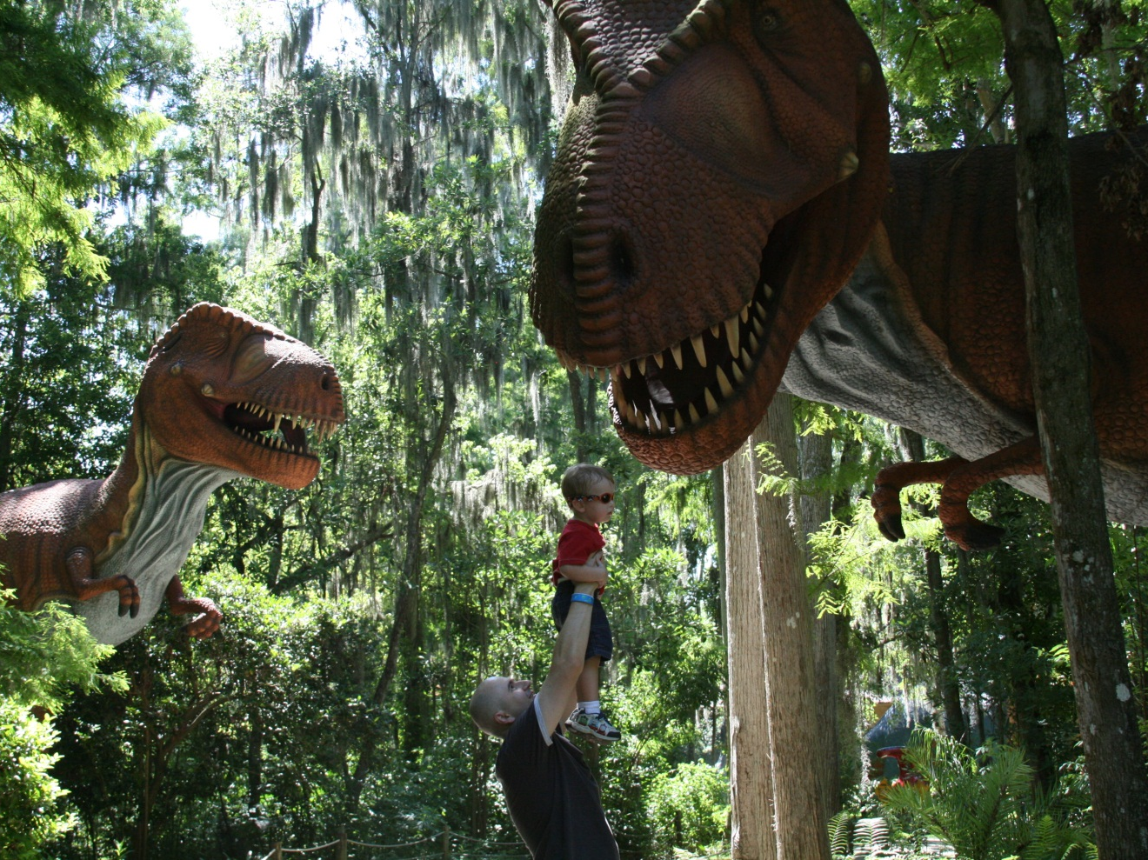
Watch steve as he feeds his first T-Rex
( not a real Child )

Slide 9

Cross The Delaware With Washington

Slide 10
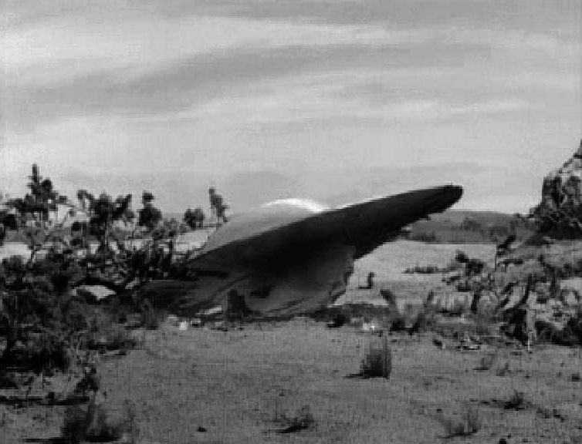
Don’t Forget To Use Invisibility Cloak!!!!!
We don’t want to repeat what happened at Roswell now do we

Slide 11

Conclusion!

